Slide 1
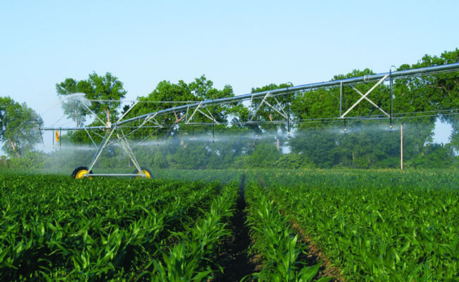
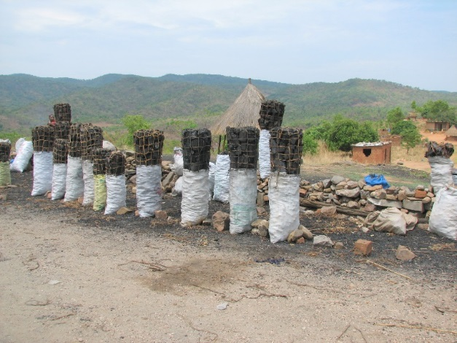
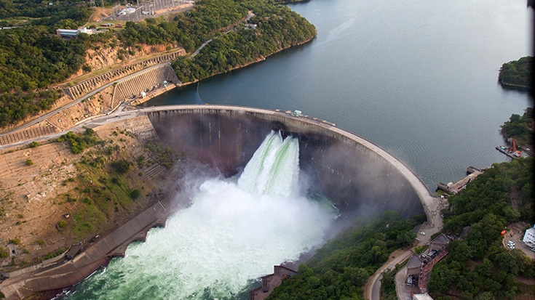
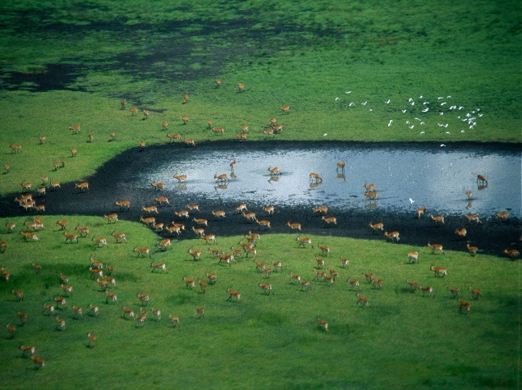
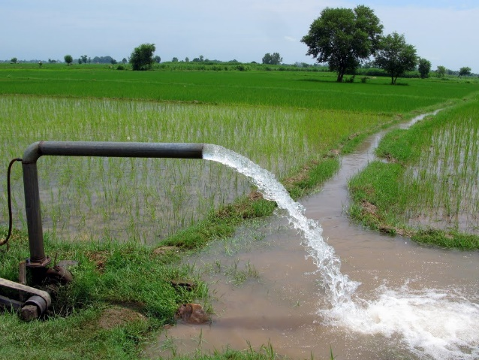
Exercise 10: Lakes and Reservoirs
Peter Burek, Mikhail Smilovic, Luca Guillaumot
International Institute for Applied Systems Analysis
Research Scholars at
Water Program

Slide 2

Hands on CWatM – Exercise 10
Compare the effect of lakes and reservoirs
Run CWatM in folder cwatm_exercise10
Look at the output in cwatm_exercise10/output
Copy output to an Excel sheet
Change the settings file and run CWatM again
Copy the output again to Excel
Notes:
Improvement in resolution of CWatM model for basin analysis to show more details locally.

Slide 3
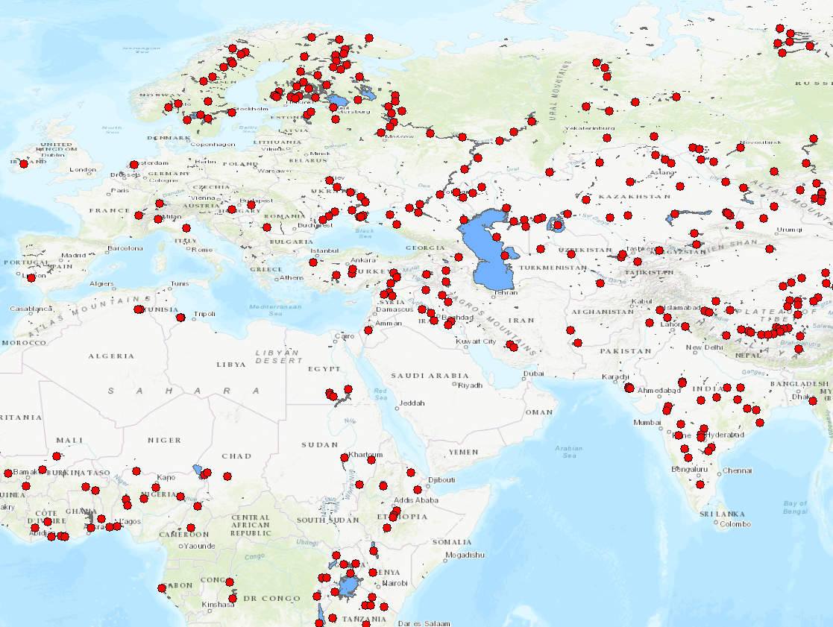
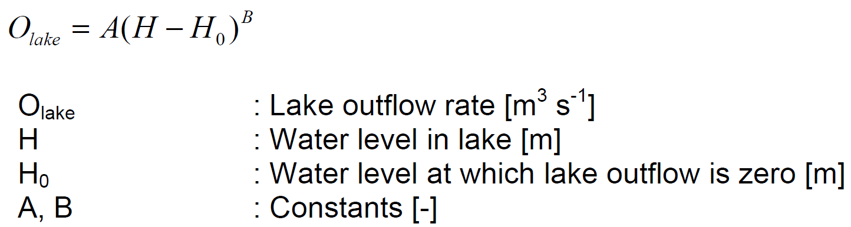
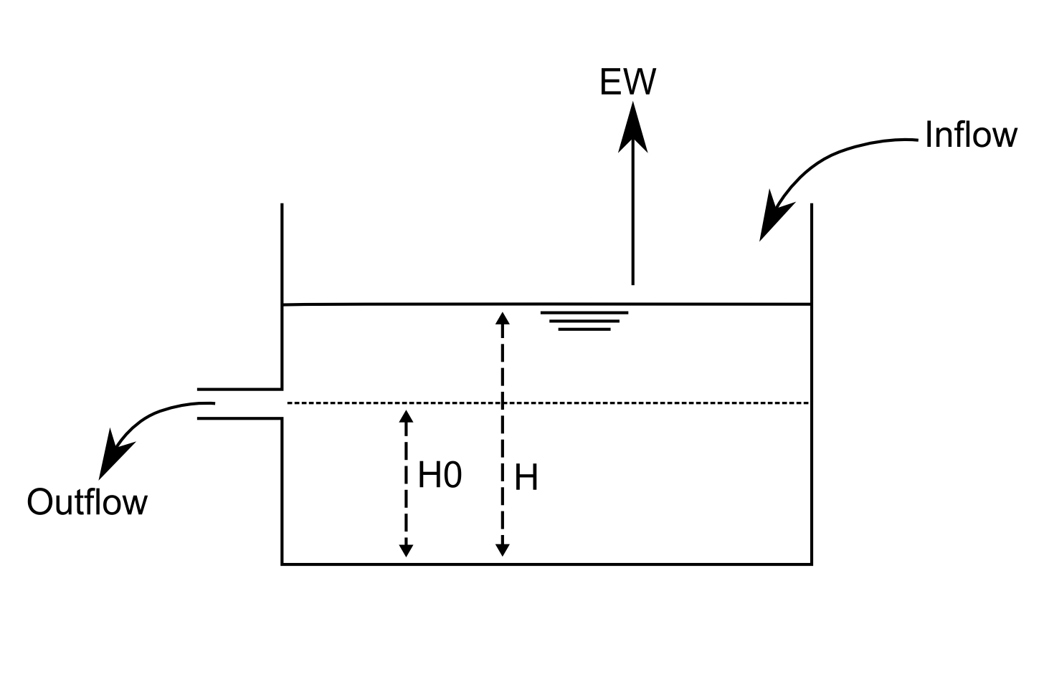
Lakes
Outflow is computed using this equation:
Lakes and reservoirs in CWatM
Schematic overview of the simulation of lakes. H0 is the water level at which the outflow is zero; H is the water level in the lake and EW is the evaporation from the lake

Slide 4
Lakes
Relation between sea level and lake storage
- linear (assuming the increase in area is neglectable)
Relation between sea level and lake outflow
non linear (weir formular)
α is a function of outlet width
outlet width is a function of discharge at outlet

Slide 5
Lakes – outlet width
Increasing outlet width
- Increasing outflow
Decreasing outlet width
- Decreasing outflow

Slide 6
Lakes – lake area
Increasing lake area
Decreasing water level
Decreasing outflow
Increasing evaporation
Decreasing lake area
Increasing water level
Increasing outflow
Decreasing evaporation

Slide 7
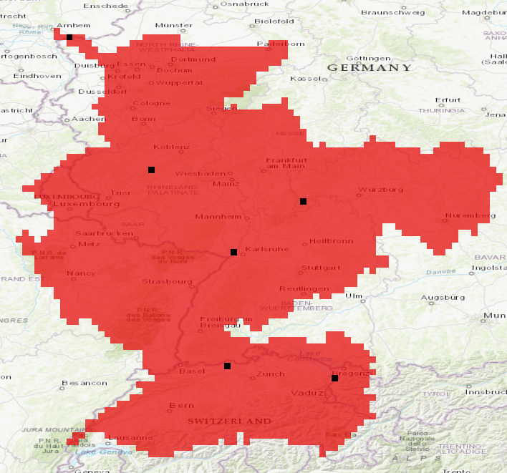
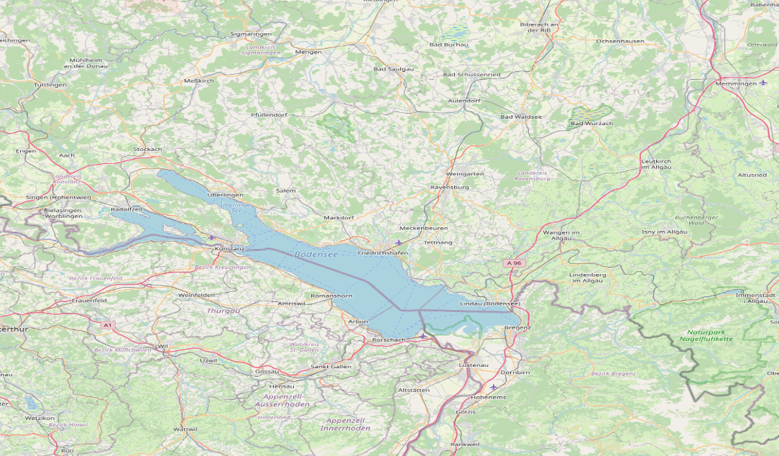
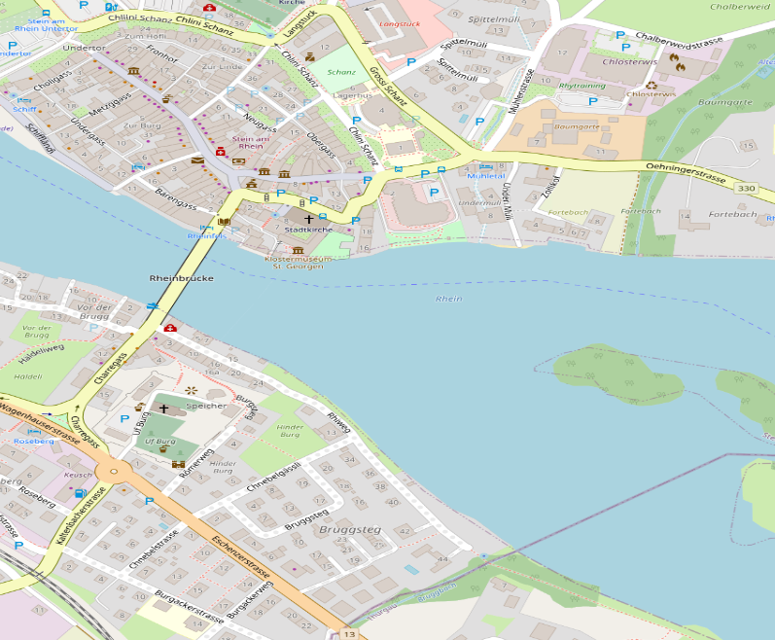
Lakes - Example
Rhine basin
Rhine – Lake Constance
Area: 536 km2
Outlet width at Stein am Rhein: 100m
Output is generated for Stein am Rhein
Stein am Rhein
Lake Constanze (Bodensee)

Slide 8
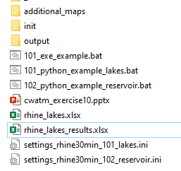
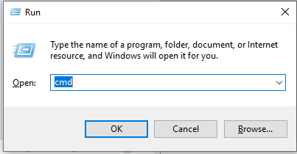
Hands on CWatM
Running CWatM
Go to folder CWATM_exercise10
Start: 101_python_example_lakes.bat or open a DOS command prompt
- press Windows+R
- type cmd + return
- change directory: e.g. cd c:/CWATM/CWATM_exercise10 (or cd “c:/directory with white space/CWATM/CWATM_exercise10”)
Type python ..\CWATM_model\CWatM\run_cwatm.py settings_rhine30min_101_lakes.ini –l
The model win run for ~ 1 min and produce a time serie for Stein am Rhein, at the outlet of Lake Constance
See ./output/discharge_daily.tss
Folder structure CWATM_exercise10
Notes:
Improvement in resolution of CWatM model for basin analysis to show more details locally.

Slide 9
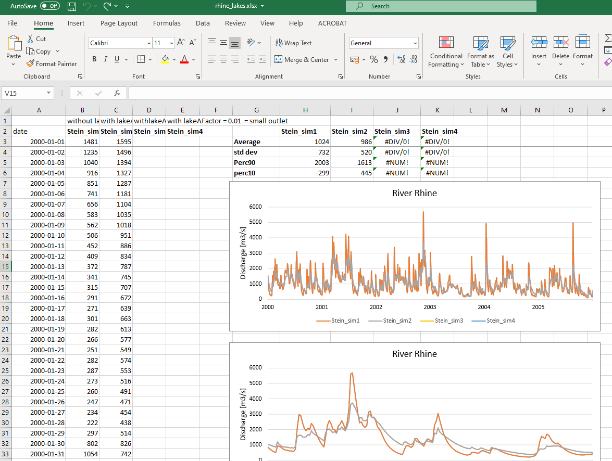
Hands on CWatM
2. Look at the output
Go into directory ./CWATM_exercise10/output
Load discharge_daily.tss into a text editor
Open ./CWATM_exercise10/rhine_lakes.xlsx
Copy content of discharge_daily.tss into rhine_lakes.xlsx with Text import Wizard in sheet rhine_lake1 in column C
Notes:
Improvement in resolution of CWatM model for basin analysis to show more details locally.

Slide 10
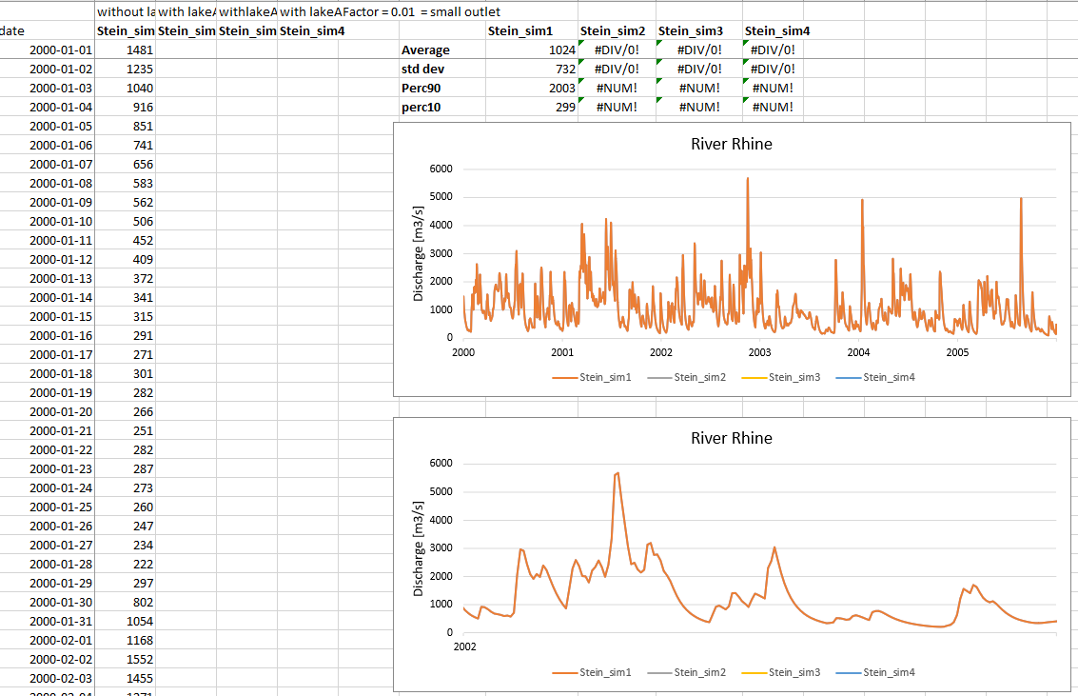
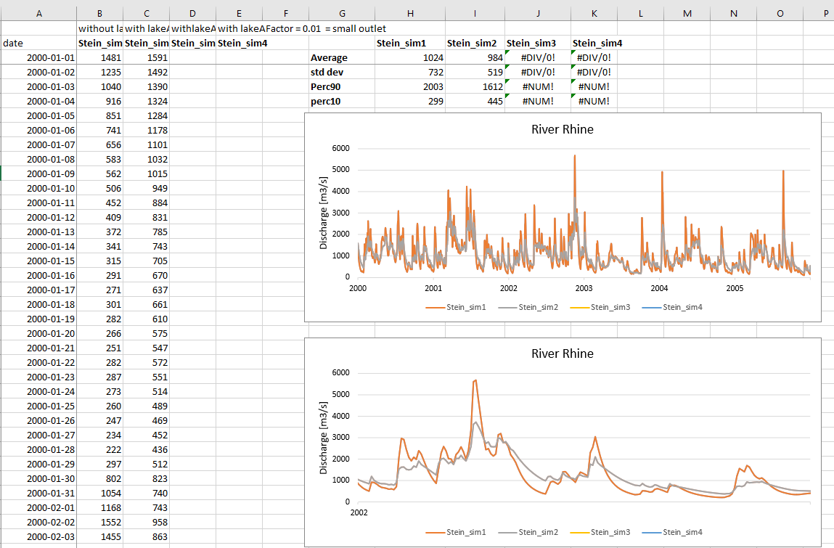
Hands on CWatM
2. Look at the output
Copy in sheet rhine_lake1 in column C
Effect of lakes
(see gray line)
Smoothening of the time series
Lower flood peaks
Higher low water
Notes:
Improvement in resolution of CWatM model for basin analysis to show more details locally.

Slide 11
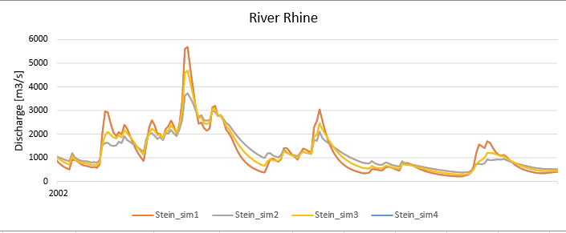
Hands on CWatM
3. Change settings file and run again
Change settingsfile: settings_rhine30min_101_lakes.ini instead lakeAFactor = 0.33 (line 179) lakeAFactor = 1.00 (outlet width is increased)
Run Start: 101_python_example_lakes.bat again
Goto step 1 to 2 and look at the difference
Orange line is without lakes
Gray line is 2nd run with lakes
Yellow line is 3rd run with outlet width is increased
What is the difference of the runs?
Why?
Notes:
Improvement in resolution of CWatM model for basin analysis to show more details locally.

Slide 12
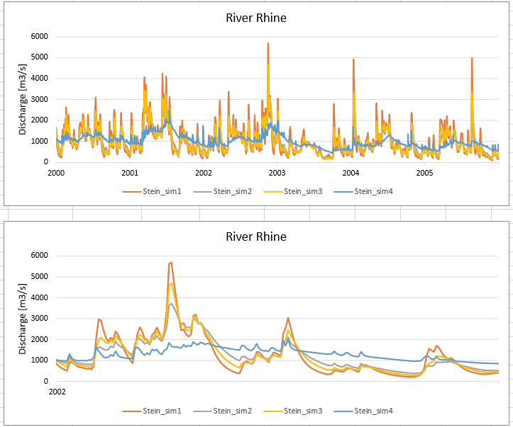
Hands on CWatM
4. Change settings file and run again
Change settingsfile: settings_rhine30min_101_lakes.ini instead lakeAFactor = 0.33 (line 179) lakeAFactor = 0.01 (outlet width is decreased a lot)
Run Start: 101_python_example_lakes.bat again
Goto step 1 to 2 and look at the difference
Orange line is without lakes
Gray line is 2nd run with lakes
Yellow line is 3rd run with outlet
width is increased
Blue line is 4th run with outlet width is decreased
Notes:
Improvement in resolution of CWatM model for basin analysis to show more details locally.

Slide 13
Reservoirs
A total storage capacity S is assigned to each reservoir, and the fraction of filling of a reservoir is calculated.
Three filling levels are defined.
a) The “conservative storage limit” fraction because a reservoir should never be completely empty
b) For prevention of damage in case of flooding, a reservoir should not be filled to the full storage capacity.
c) the “normal storage limit” defines the buffering capacity and the available storage of a reservoir
Between the state of flood and conservative storage limit, a reservoir is managed as much as possible to deliver a constant outflow so that there is also a constant energy output from hydropower generation

Slide 14
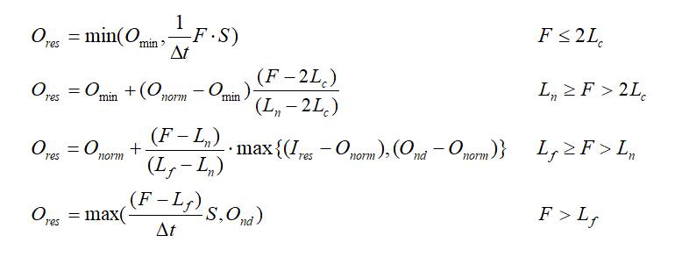
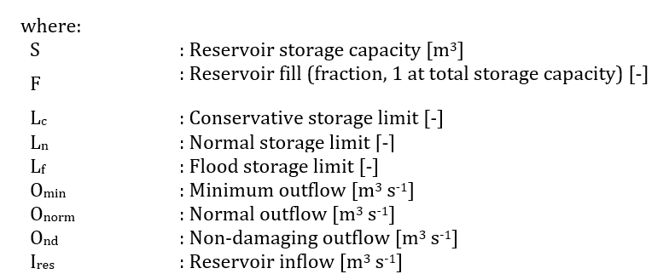
Reservoirs
Equation of 4 rules:
If storage filling is less equal 2 x conservative filling
-> try to preserve a minimum flow
If storage filling is lower equal normal filling
-> try to get close to normal outflow (adding water from reservoir)
If storage filling is above normal filling
-> try to get close to normal outflow
(storing water in the reservoir)
If storage filling is above flood storage filling
-> to prevent flood damage

Slide 15
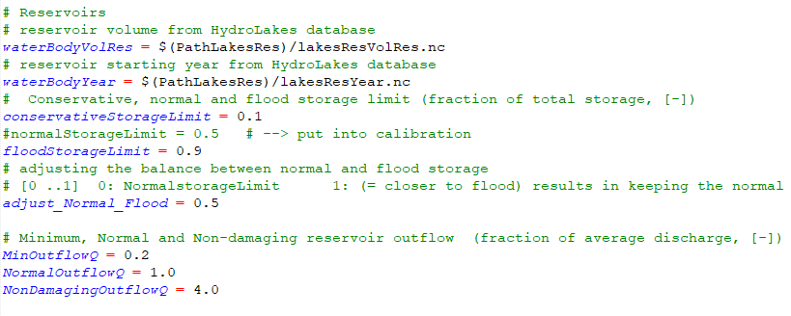
Reservoirs
Data for reservoirs
Reservoir volume - lakesResVolRes.nc
Reservoir type - lakesResType.nc (1 is a lake, 2 is a reservoir)
Reservoir year - lakesResYear.nc (when is a reservoir activated)
Parameter for reservoirs in the settingsfile

Slide 16
Hands on CWatM
5. Running CWatM
Go to folder CWATM_exercise10
Start: 102_python_example_reservoir.bat or open a DOS command prompt
- press Windows+R
- type cmd + return
- change directory: e.g. cd c:/CWATM/CWATM_exercise10 (or cd “c:/directory with white space/CWATM/CWATM_exercise10”)
Type python ..\CWATM_model\CWatM\run_cwatm.py settings_rhine30min_102_reservoir.ini –l
The model win run for ~ 1 min and produce a time serie for Stein am Rhein, at the outlet of Lake Constance
See ./output/discharge_daily.tss
Folder structure CWATM_exercise10
Notes:
Improvement in resolution of CWatM model for basin analysis to show more details locally.

Slide 17
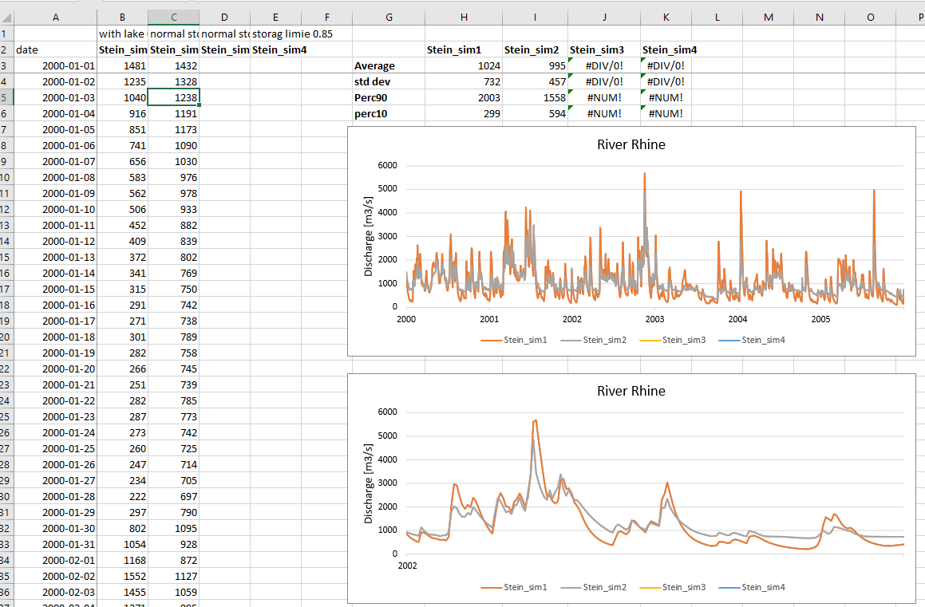
Hands on CWatM
6. Look at the output
Go into directory ./CWATM_exercise10/output
Load discharge_daily.tss into a text editor
Open ./CWATM_exercise10/rhine_lakes.xlsx
Copy content of discharge_daily.tss into rhine_lakes.xlsx with Text import Wizard in sheet rhine_reservoir1 in column C
Notes:
Improvement in resolution of CWatM model for basin analysis to show more details locally.

Slide 18
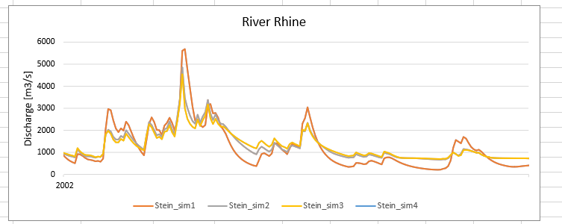
Hands on CWatM
7. Change settings file and run again
Change settingsfile: settings_rhine30min_102_reservoir.ini instead normalStorageLimit = 0.44 (line 177) normalStorageLimit = 0.15
Run Start: 102_python_example_reservoir.bat again
Goto step 1 to 2 and look at the difference
Orange line is without reservoirs
Gray line is 2nd run with reservoirs
Yellow line is 3rd run with
normalStorageLimit = 0.15
Notes:
Improvement in resolution of CWatM model for basin analysis to show more details locally.

Slide 19
Problems
Most problems come from different file systems, folder structures
We try to set up everything with relative path.
Please make sure that your folders have a similar structure like in slide 3 in cwatm_exercise1.ppt
The settings file has a part:
[FILE_PATHS]
PathRoot = ../cwatm_data ../ jumps back to the previous folder
PathOut = ./output ./ uses the folder output in the same folder as the settings file or the directory you are in
PathMaps = $(PathRoot)/cwatm_input30min
PathMeteo = $(PathRoot)/climate/rhine
3. If this is not working you can use also absolute path (also with white space)
PathRoot = C/root directory/second.root/cwatm/cwatm_data
4. If you execute cwatm you can also use absolute path
instead
../CWATM_model/CWatMexe/cwatm.exe settings_rhine30min.ini –l
“C/root directory/second.root/cwatm/CWATM_model/CWatMexe/cwatm.exe” settings_rhine30min.ini –l (mind the “ if there are white spaces)
5. Some other errors we address in:
https://cwatm.iiasa.ac.at/tutorial.html#test-the-python-model-version
Notes:
Improvement in resolution of CWatM model for basin analysis to show more details locally.

